Slide 1
Big Data Analysis and Mining
Junming Shao

Slide 2
Lecture 7
Hadoop/Spark

Slide 3
What is Hadoop
Hadoop is a software framework for distributed processing of large datasets across large clusters of computers
Large datasets → Terabytes or petabytes of data
Large clusters → hundreds or thousands of nodes
Hadoop is open-source implementation for Google MapReduce
Hadoop is based on a simple programming model called MapReduce
Hadoop is based on a simple data model, any data will fit

Slide 4
Design Principles of Hadoop
Need to process big data
Need to parallelize computation across thousands of nodes
Commodity hardware
Large number of low-end cheap machines working in parallel to solve a computing problem
This is in contrast to Parallel DBs
Small number of high-end expensive machines

Slide 5

Divide and Conquer
“Work”
Partition
w₁
w₂
w₃
“worker”
“worker”
“worker”
r₁
r₂
r₃
Combine
“Result”

Slide 6
Fundamental issues
scheduling, data distribution, synchronization, inter-process communication, robustness, fault tolerance, …
Different programming models
Message Passing
Shared Memory
Memory
P₁
P₂
P₃
P₄
P₅
P₁
P₂
P₃
P₄
P₅
Architectural issues
Flynn’s taxonomy (SIMD, MIMD, etc.), network typology, bisection bandwidth UMA vs. NUMA, cache coherence
Different programming constructs
mutexes, conditional variables, barriers, …
masters/slaves, producers/consumers, work queues, …
Common problems
livelock, deadlock, data starvation, priority inversion…
dining philosophers, sleeping barbers, cigarette smokers, …
The reality: programmer shoulders the burden of managing concurrency…

Slide 7
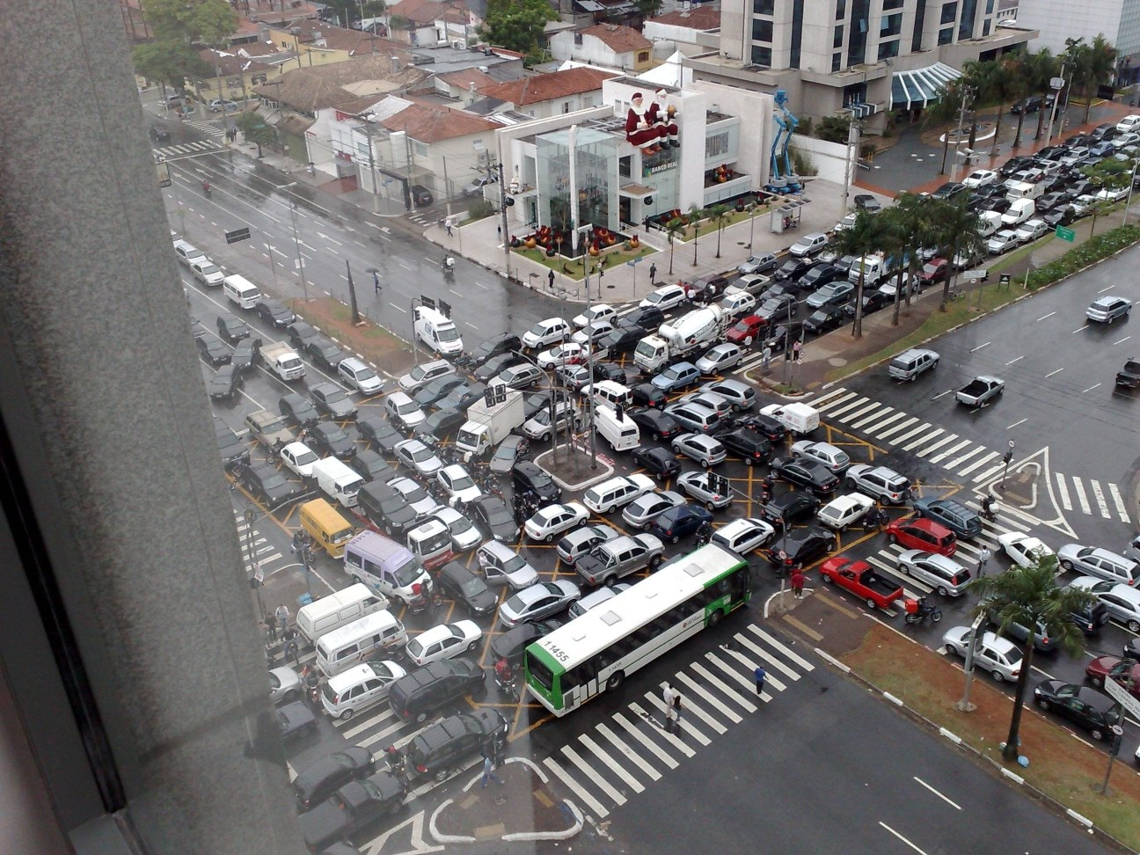
Source: Ricardo Guimarães Herrmann

Slide 8
Design Principles of Hadoop
Automatic parallelization & distribution
Hidden from the end-user
Fault tolerance and automatic recovery
Nodes/tasks will fail and will recover automatically
Clean and simple programming abstraction
Users only provide two functions “map” and “reduce”

Slide 9
Distributed File System
Don’t move data to workers… move workers to the data!
Store data on the local disks of nodes in the cluster
Start up the workers on the node that has the data local
Why?
Not enough RAM to hold all the data in memory
Disk access is slow, but disk throughput is reasonable
A distributed file system is the answer
GFS (Google File System)
HDFS for Hadoop (= GFS clone)

Slide 10
Hadoop: How it Works
Don’t move data to workers… move workers to the data!
Store data on the local disks of nodes in the cluster
Start up the workers on the node that has the data local
Why?
Not enough RAM to hold all the data in memory
Disk access is slow, but disk throughput is reasonable
A distributed file system is the answer
GFS (Google File System)
HDFS for Hadoop (= GFS clone)

Slide 11
Hadoop: How it Works
HBase
Pig
Hive
Chukwa
MapReduce
HDFS
Zoo
Keeper
Core
Avro
Hadoop’s stated mission (Doug Cutting interview):
Commoditize infrastructure for web-scale,
data-intensive applications

Slide 12
Hadoop: How it Works
HBase
Pig
Hive
Chukwa
Filesystems and I/O:
Abstraction APIs
RPC / Persistence
MapReduce
HDFS
Zoo
Keeper
Core
Avro

Slide 13
Hadoop: How it Works
HBase
Pig
Hive
Chukwa
Cross-language serialization:
RPC / persistence
~ Google ProtoBuf / FB Thrift
MapReduce
HDFS
Zoo
Keeper
Core
Avro

Slide 14
Hadoop: How it Works
Distributed execution (batch)
Programming model
Scalability / fault-tolerance
HBase
Pig
Hive
Chukwa
MapReduce
HDFS
Zoo
Keeper
Core
Avro

Slide 15
Hadoop: How it Works
Distributed storage (read-opt.)
Replication / scalability
~ Google filesystem (GFS)
HBase
Pig
Hive
Chukwa
MapReduce
HDFS
Zoo
Keeper
Core
Avro

Slide 16
Hadoop: How it Works
Coordination service
Locking / configuration
~ Google Chubby
HBase
Pig
Hive
Chukwa
MapReduce
HDFS
Zoo
Keeper
Core
Avro

Slide 17
Hadoop: How it Works
HBase
Pig
Hive
Chukwa
MapReduce
HDFS
Zoo
Keeper
Column-oriented, sparse store
Batch & random access
~ Google BigTable
Core
Avro

Slide 18
Hadoop: How it Works
HBase
Pig
Hive
Chukwa
MapReduce
HDFS
Zoo
Keeper
Data flow language
Procedural SQL-inspired lang.
Execution environment
Core
Avro

Slide 19
Hadoop: How it Works
HBase
Pig
Hive
Chukwa
MapReduce
HDFS
Zoo
Keeper
Distributed data warehouse
SQL-like query language
Data mgmt / query execution
Core
Avro

Slide 20
Hadoop: How it Works
HBase
Pig
Hive
Chukwa
… … more
MapReduce
HDFS
Zoo
Keeper
Core
Avro

Slide 21
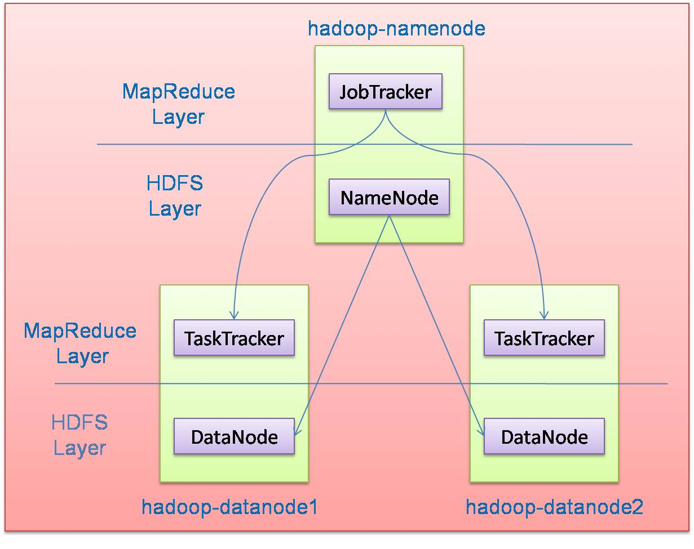
Hadoop Architecture
Distributed file system (HDFS)
Execution engine (MapReduce)
Master node (single node)
Many slave nodes

Slide 22
1、HDFS

Slide 23
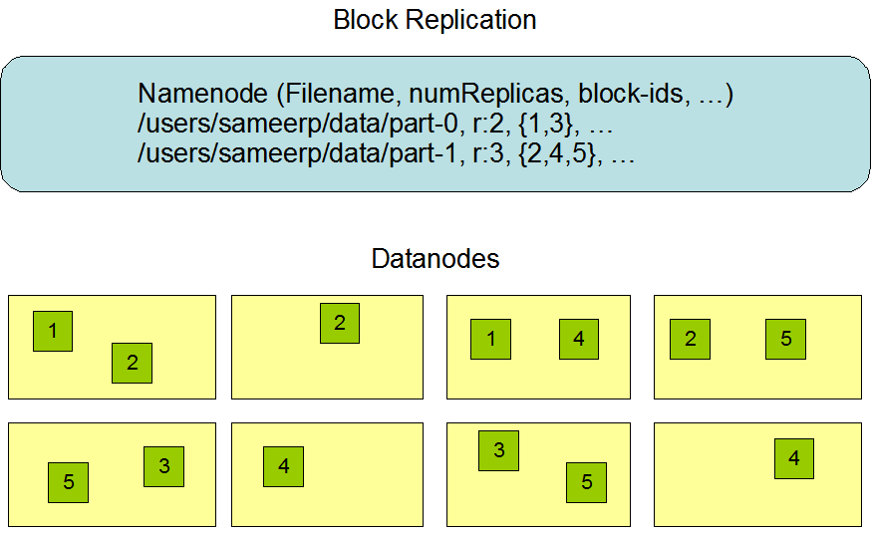
Hadoop Distributed File System (HDFS)
Centralized namenode
- Maintains metadata info about files
File F
1
2
3
4
5
Blocks (64 MB)
Many datanode (1000s)
- Store the actual data
- Files are divided into blocks
- Each block is replicated N times
(Default = 3)

Slide 24
Main Properties of HDFS
Large: A HDFS instance may consist of thousands of server machines, each storing part of the file system’s data
Replication: Each data block is replicated many times (default is 3)
Failure: Failure is the norm rather than exception
Fault Tolerance: Detection of faults and quick, automatic recovery from them is a core architectural goal of HDFS
Namenode is consistently checking Datanodes

Slide 25
HDFS
NameNode
Managing FsImage file and EditLog file to manager meta information
FsImage: Namespace, system properties, block mapping information…
EditLog: Record every change to file system metadata
EditLog is used to update FsImage (Checkpoint).
DataNode
Store data
Block operation
HeartBeat BlockReport
Location： ${dfs.namenode.name.dir}/current/
Notes:
心跳发了，发现replica数量不对！Safe mode is on!
你要等它复制好+30s，safe mode自然就退出了。当然也可以强制退出

Slide 26
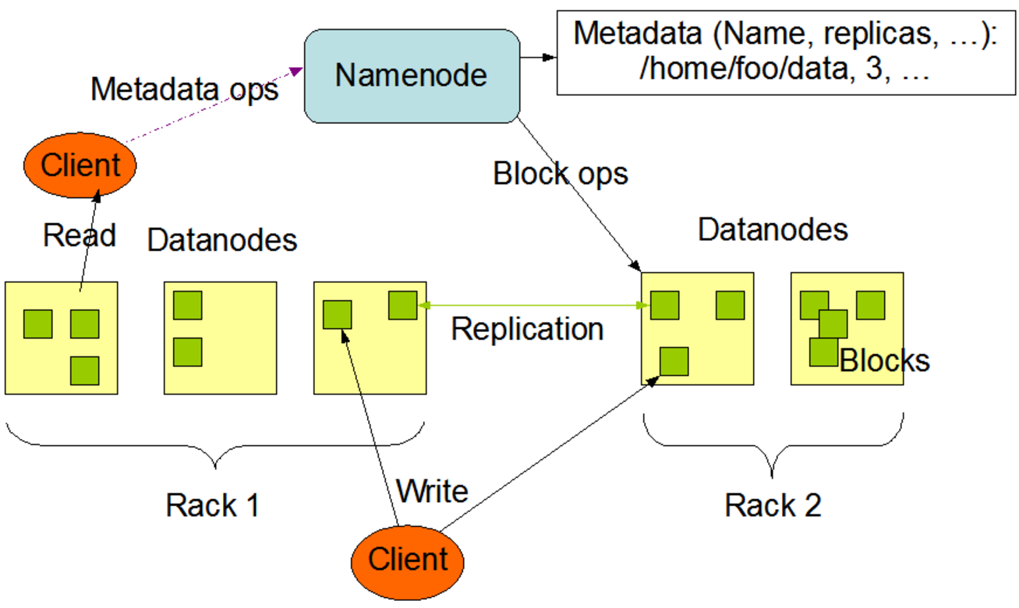
Fault Tolerance
HeartBeat & BlockReport
HeartBeat + BlockReport
Notes:
为了保证整个班级的正常次序，班长需要定期的点名，检查是否有童鞋上课睡觉。这里的namenode并不会主动点名，而是让各个datanode主动汇报，定期的给namenode发送信息。信息包括两部分，心跳检测（HeartBeat）和数据块汇报信息（BlockReport）。前者告诉namenode，datanode还活着；后者是该datanode上数据块的信息。

Slide 27
Fault Tolerance
HeartBeat & BlockReport
HeartBeat is received
If fail to reach the minimum number of replicas, Safe Mode is on.
You wait. OR “ hdfs dfsadmin –safemode leave ”
HeartBeat is NOT received (over 10 mins by default)
DataNode is dead
Re-replica
Assign no more job to any dead DataNode
Notes:
如果HeartBeat和BlockReport被namenode收到了
namenode会汇总大家的blockreport，检测文件的数据块是否有丢失，数据块的复制数是否达到要求。如果没有达到要求，集群会进入Safe Mode。
如果namenode超过10min还没有收到某个datanode的HeartBeat
namenode会将这个datanode标记为挂了，然后将原本存储在这个datanode上的数据块，重新复制到其他节点上，并且以后的计算任务也不会再发送给这个datanode了。

Slide 28
Fault Tolerance
What if NameNode is dead?
Second NameNode (Since Hadoop 1.X)
High Availability，HA (Since Hadoop 2.X)
Standby / Active NameNode
Journal Node
Notes:
当然，班长namenode也可能会挂掉。一旦班长挂了，整个班级都约等于挂了。为了防止这个情况，允许集群的更好的容错能力，Hadoop 1.X启动了副班长策略，引入了Second Namenode。second namenode负责FsImage和EditLog两个文件的合并，减轻namenode的负担（如下图）。

Slide 29
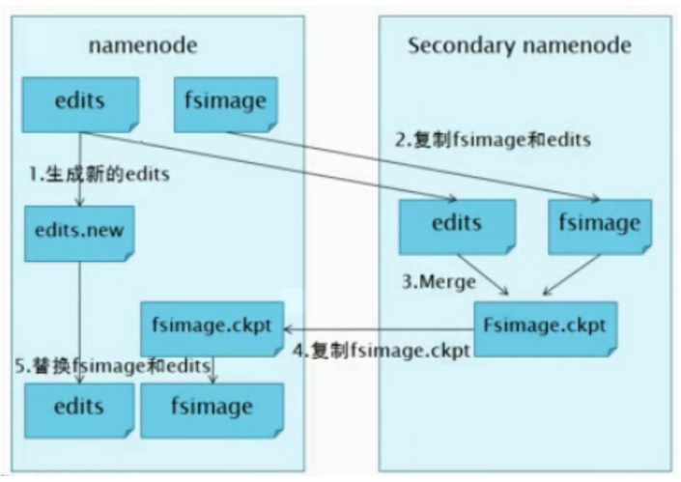
Fault Tolerance
What if NameNode is dead?
Second NameNode (Since Hadoop 1.X)
Notes:
当namenode挂掉了，second namenode上会保存有最新的FsImage文件。那么集群管理狗就可以将这份FsImage拷贝到namenode上，然后人工重启namenode。所以second namenode不提供namenode的故障处理，它仅仅是减轻namenode的压力而已。

Slide 30
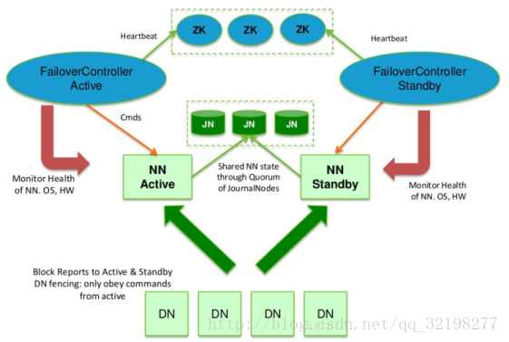
Fault Tolerance
What if NameNode is dead?
一个NN工作,另一个随时待命。关键在于如何保证两个NN的一致性
HA (Since Hadoop 2.X)
Notes:
要达到故障处理的要求，Hadoop 2.X之后提供了Hadoop HA策略。但是，注意，HA和second namenode策略不能同时使用。Hadoop HA的框架图如下：
Hadoop HA引入了两个Namenode，即Active Namename和Standby Namenode。但是只有一个提供集群服务，而另一个就standby。一旦active namenode挂了，standby的就立刻上线。至于一开始，哪个namenode充当active的，取决于Zookeeper。Zookeeper提供master选举的作用，这个选举实际上是一个抢占式的锁机制，两个namenode谁先到谁就是active的。
1. 一个Active NN，一个standby。达到故障处理的目的。一个挂了，另一个马上上线。
3. 需要保证FSIamgehe editlog的一致性，所以DN需要向两个NN发送心跳。一致性由JN保证

Slide 31
Fault Tolerance
What if NameNode is dead?
DN需要向两个NN发送心跳。一致性由JN保证
Notes:
standby namenode需要和active namenode的元信息一致，才能在active one宕掉之后，立刻提供一致服务。为了让元信息一致：
集群里的datanode需要同时向两个namenode发送心跳和blockreport；
active namenode对EditLog的修改需要同时写入JournalNodes（也就是图中的JN）。一般来说，有2N+1台 JN 来存储EditLog，每次写数据操作有大多数（>=N+1）返回成功时即认为该次写成功。同时，也容忍了最多有N台机器挂掉，如果多于N台挂掉，这个算法就失效了。
任何修改操作在 Active NN上执行时，JN进程同时也会记录修改log到至少半数以上的JN中，这时 Standby NN 监测到JN 里面的同步log发生变化了会读取 JN 里面的修改log，然后同步到自己的的目录镜像树里面.
最后，图中的FailoverController监控了NameNode的状态，并且通过心跳机制，监控自己在zookeeper中的状态。一旦active namenode挂了，则触发standby的namenode上线。

Slide 32
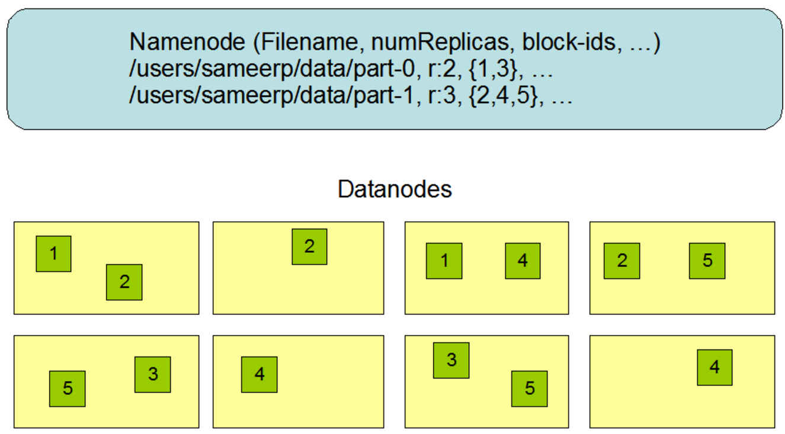
Data Storage
Data block
Supports write-once-read-many semantics on files
An HDFS file is chopped up into 128/64 MB (default) blocks with multiple replicas (3 by default).
Read file in parallel V.S. Disk I/ O
Notes:
并发读意味着block越小越好。但是会增加磁盘寻址时间

Slide 33
Data Storage
Data block
Supports write-once-read-many semantics on files
An HDFS file is chopped up into 128 MB (default) blocks with multiple replicas (3 by default).
Read file in parallel V.S. Disk I/ O
The number of maps is usually driven by the total size of the inputs, that is, the total number of blocks of the input files。

Slide 34
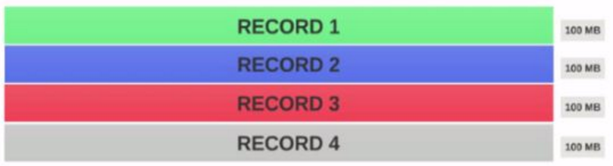
Data Storage
Data Block & InputSplit
A file of 400MB with consists of 4 records

Slide 35
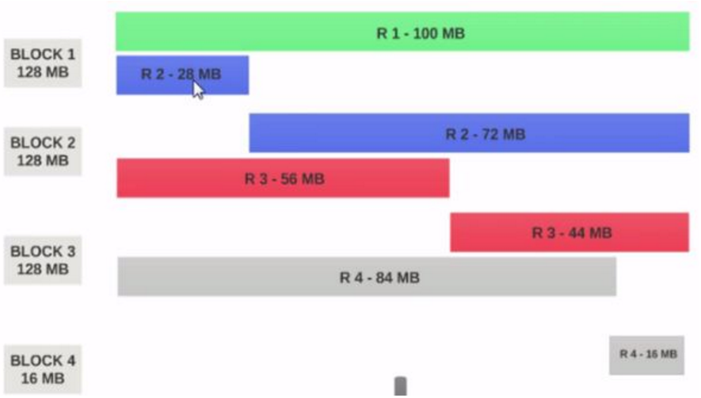
Data Storage
Data Block & InputSplit
Problem： If a mapper is to be run on Block 1, the mapper cannot process.
Notes:
This is the exact problem that input splits solve.

Slide 36
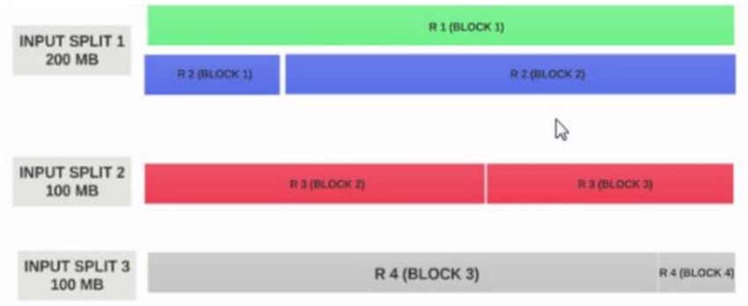
Data Storage
Data Block & InputSplit
Solution： InputSplit respects logical record boundaries （逻辑分块）.
Notes:
Assume the input split size is 200MB

Slide 37
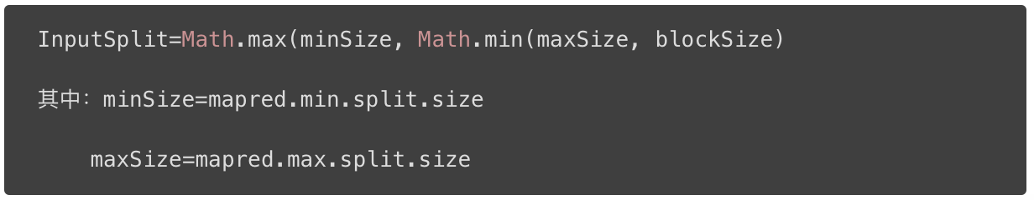
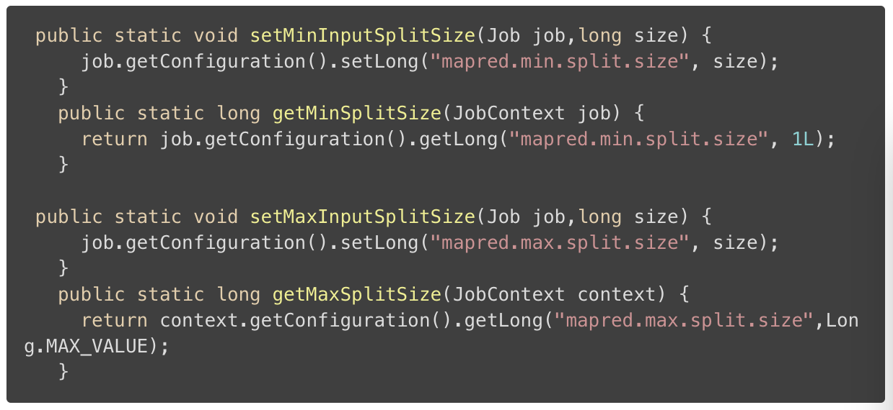
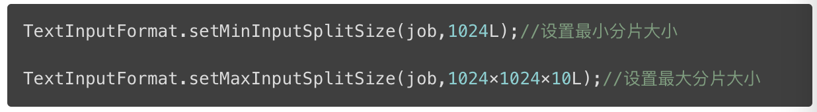
假如想要设置的分片大小为10MB，可以在MapReduce程序的驱动部分添加

Slide 38
2、MapReduce

Slide 39
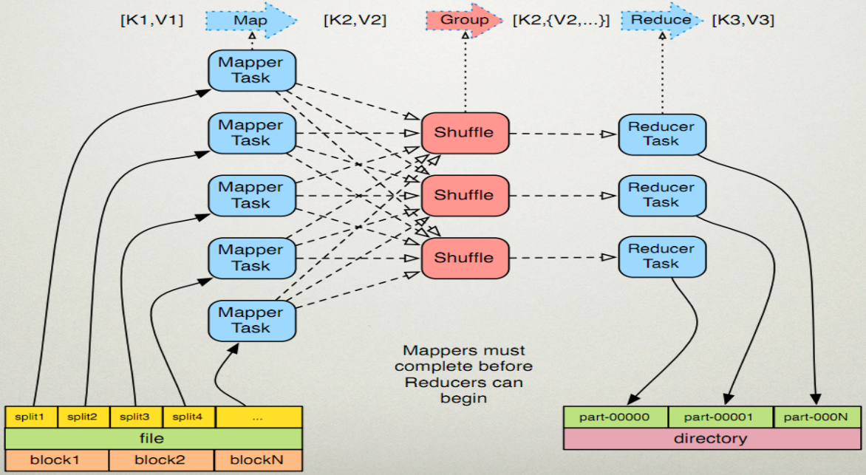
MapReduce
Procedure

Slide 40
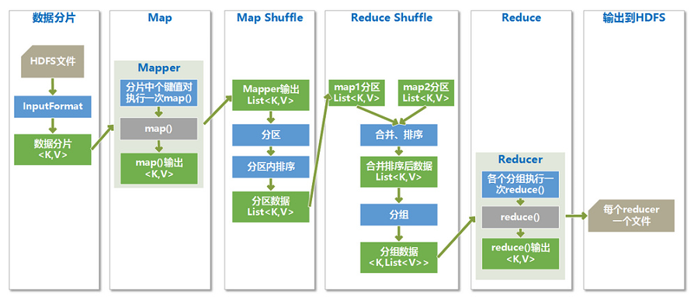
MapReduce
Details
Notes:
结果分区：在经过mapper的运行后，我们得到一组键值对(key，value)，而对特定的(key，value)交给哪个reduce task处理，默认是对key hash后再以reduce task数量取模（即放在第(key % numReduce)个reduce上执行）。默认的取模方式只是为了平均reduce的处理能力，如果用户自己对Partitioner有需求，可以订制并设置到job上。分区之后要写入一个数据缓存区，写入之前(key,value)对会被序列化成字节数组

Slide 41
Map-Reduce Execution Engine (Example: Color Count)
Input blocks on HDFS
Produces (k, v)
( , 1)
Shuffle & Sorting based on k
Consumes(k, [v])
( , [1,1,1,1,1,1..])
Produces(k’, v’)
( , 100)
Users only provide the “Map” and “Reduce” functions

Slide 42
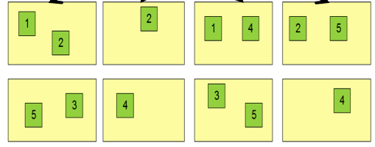
Properties of MapReduce Engine
Job Tracker is the master node (runs with the namenode)
Receives the user’s job
Decides on how many tasks will run (number of mappers)
Decides on where to run each mapper (concept of locality)
Node 1
Node 2
Node 3
This file has 5 Blocks → run 5 map tasks
Where to run the task reading block “1”
Try to run it on Node 1 or Node 3

Slide 43
Properties of MapReduce Engine (Cont’d)
Task Tracker is the slave node (runs on each datanode)
Receives the task from Job Tracker
Runs the task until completion (either map or reduce task)
Always in communication with the Job Tracker reporting progress
In this example, 1 map-reduce job consists of 4 map tasks and 3 reduce tasks

Slide 44
Key-Value Pairs
Mappers and Reducers are users’ code (provided functions)
Just need to obey the Key-Value pairs interface
Mappers:
Consume <key, value> pairs
Produce <key, value> pairs
Reducers:
Consume <key, <list of values>>
Produce <key, value>
Shuffling and Sorting:
Hidden phase between mappers and reducers
Groups all similar keys from all mappers, sorts and passes them to a certain reducer in the form of <key, <list of values>>

Slide 45
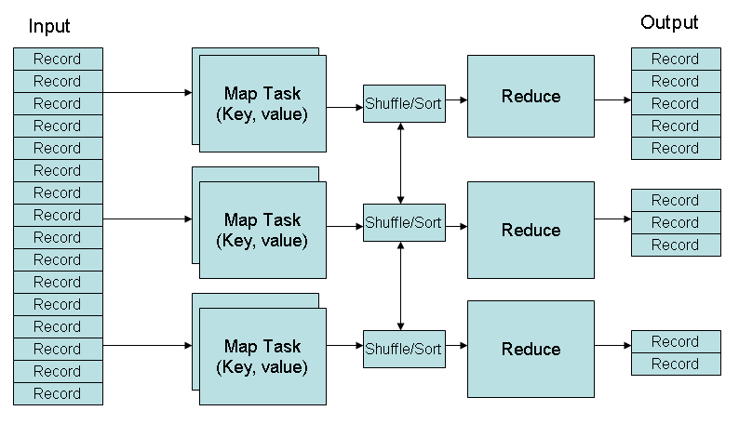
MapReduce Phases
Deciding on what will be the key and what will be the value ➔ developer’s responsibility

Slide 46
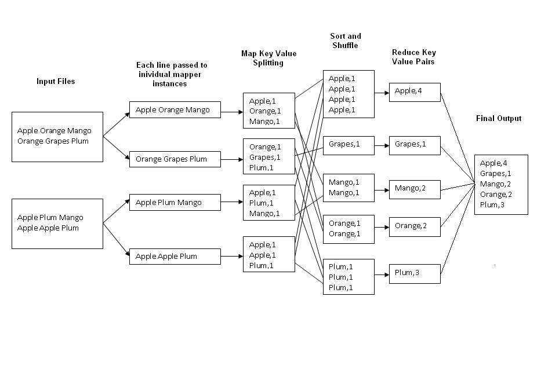
Example 1: Word Count
Job: Count the occurrences of each word in a data set

Slide 47
package wordsCount;
import java.io.IOException;
import java.util.StringTokenizer;
import org.apache.hadoop.io.IntWritable;
import org.apache.hadoop.io.LongWritable;
import org.apache.hadoop.io.Text;
import org.apache.hadoop.mapreduce.Mapper;
public class WordsMapper extends Mapper<LongWritable, Text, Text, IntWritable>{
@Override
protected void map(LongWritable key, Text value, Mapper<LongWritable, Text, Text, IntWritable> . Context context) throws IOException, InterruptedException {
String line = value.toString();
StringTokenizer st = new StringTokenizer(line);
while(st.hasMoreTokens()){
String word = st.nextToken();
context.write(new Text(word), new IntWritable(1));
}
}
}

Slide 48
package wordsCount;
import java.io.IOException;
import org.apache.hadoop.io.IntWritable;
import org.apache.hadoop.io.Text;
import org.apache.hadoop.mapreduce.Reducer;
public class WordsReduce extends Reducer<Text, IntWritable, Text, IntWritable>{
@Override
protected void reduce(Text key, Iterable<IntWritable> iterator,
Reducer<Text, IntWritable, Text, IntWritable>.Context context) throws IOException, InterruptedException {
// TODO 自动生成的方法存根
int sum = 0;
for(IntWritable i:iterator){
sum = sum + i.get();
}
context.write(key, new IntWritable(sum));
}
}

Slide 49
package wordsCount;
import org.apache.hadoop.conf.Configuration;
import org.apache.hadoop.fs.Path;
import org.apache.hadoop.io.IntWritable;
import org.apache.hadoop.io.Text;
import org.apache.hadoop.mapreduce.Job;
import org.apache.hadoop.mapreduce.lib.input.FileInputFormat;
import org.apache.hadoop.mapreduce.lib.input.TextInputFormat;
import org.apache.hadoop.mapreduce.lib.output.FileOutputFormat;
import org.apache.hadoop.mapreduce.lib.output.TextOutputFormat;
public class Run {
public static void main(String[] args) throws Exception{
// TODO 自动生成的方法存根
Configuration configuration = new Configuration();
Job job = new Job(configuration);
job.setJarByClass(Run.class);
job.setJobName("words count!");

Slide 50
job.setOutputKeyClass(Text.class);
job.setOutputValueClass(IntWritable.class);
job.setInputFormatClass(TextInputFormat.class);
job.setOutputFormatClass(TextOutputFormat.class);
job.setMapperClass(WordsMapper.class);
job.setReducerClass(WordsReduce.class);
FileInputFormat.addInputPath(job, new Path("hdfs://192.168.1.111:9000/user/input/wc/"));
FileOutputFormat.setOutputPath(job,new Path("hdfs://192.168.1.111:9000/user/result/"));
job.waitForCompletion(true);
}
}

Slide 51
Example 2: Color Count
Job: Count the number of each color in a data set
Input blocks on HDFS
Produces (k, v)
( , 1)
Shuffle & Sorting based on k
Consumes(k, [v])
( , [1,1,1,1,1,1..])
Produces(k’, v’)
( , 100)
Part0001
Part0002
Part0003
That’s the output file, it has 3 parts on probably 3 different machines
51

Slide 52
Example 3: Color Filter
Job: Select only the blue and the green colors
Each map task will select only the blue or green colors
No need for reduce phase
Input blocks on HDFS
Produces (k, v)
( , 1)
Write to HDFS
Part0001
Write to HDFS
Part0002
That’s the output file, it has 4 parts on probably 4 different machines
Write to HDFS
Part0003
Write to HDFS
Part0004

Slide 53
Example 3: Color Filter
Job: Select only the blue and the green colors
Each map task will select only the blue or green colors
No need for reduce phase
Input blocks on HDFS
Produces (k, v)
( , 1)
Write to HDFS
Part0001
Write to HDFS
Part0002
That’s the output file, it has 4 parts on probably 4 different machines
Write to HDFS
Part0003
Write to HDFS
Part0004

Slide 54
MapReduce – KMeans
KmeansIter()
Map(p) // Assign Cluster
For c in clusters:
If dist(p,c)<minDist, then minC=c, minDist = dist(p,c)
Emit(minC.id, (p, 1))
Reduce() //Update Centroids
For all values (p, c) :
total += p; count += c;
Emit(key, (total, count))
Map1
Map2
Initial centroids

Slide 55
MapReduce – KMeans
KmeansIter()
Map(p) // Assign Cluster
For c in clusters:
If dist(p,c)<minDist, then minC=c, minDist = dist(p,c)
Emit(minC.id, (p, 1))
Reduce() //Update Centroids
For all values (p, c) :
total += p; count += c;
Emit(key, (total, count))
Map: assign each p to closest centroids
1
3
Reduce: update each centroid with its new location (total, count)
2
4
Map1
Map2
Initial centroids
Reduce1
Reduce2

Slide 56
MapReduce kNN
K=3
Map()
Input:
All points
query point p
Output: k nearest neighbors (local)
Emit the k closest points to p
1
0
1
1
1
0
1
0
1
1
1
0
0
0
0
1
0
Reduce()
Input:
Key: null; values: local neighbors
query point p
Output: k nearest neighbors (global)
Emit the k closest points to p among all local neighbors
Map1
Map2
Query point
Reduce

Slide 57
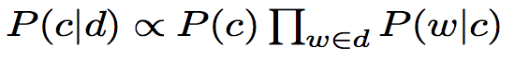
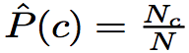
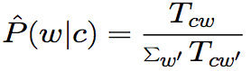


Naïve Bayes
c is a class label, d is a doc, w is a word
Formulation:
Parameter estimation
Class prior:
Conditional probability:
where N_{c} is #docs in c, N is #docs
T_{cw} is # of occurrences of w in class c
d1
Goals:
total number of docs N
number of docs in c:N_{c}
word count histogram in c:T_{cw}
total word count in c:∑T_{cw’}
d2
c1:
N₁=3
T_{1w}
d3
d4
T_{2w}
d5
c2:
N₂=4
d6
d7
Term vector
57

Slide 58
MapReduce: Naïve Bayes
ClassPrior()
Map(doc): Emit(class_id, (doc_id, doc_length)
Combine()/Reduce()
N_{c} = 0; sTcw = 0
For each doc_id:
N_{c}++; sTcw +=doc_length
Emit(c, (N_{c} , sTcw))
Goals:
total number of docs N
number of docs in c:N_{c}
word count histogram in c:T_{cw}
total word count in c:∑T_{cw’}
ConditionalProbability()
Map(doc):
For each word w in doc:
Emit(pair(c, w) , 1)
Combine()/Reduce()
T_{cw} = 0
For each value v: T_{cw} += v
Emit(pair(c, w) , T_{cw})
Naïve Bayes can be implemented using MapReduce jobs of histogram computation
58

Slide 59
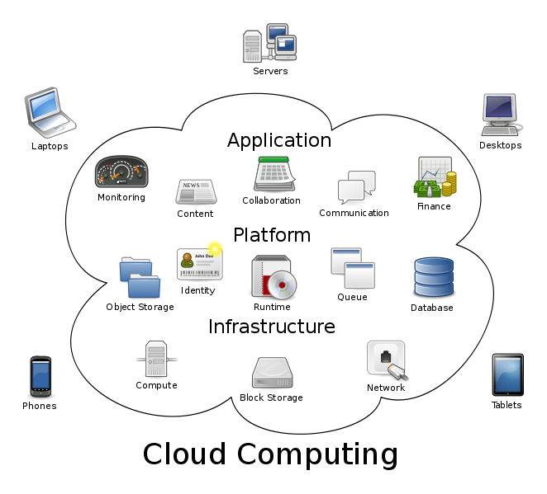
Bigger Picture: Hadoop vs. Other Systems
 | Distributed Databases | Hadoop
Computing Model | Notion of transactions Transaction is the unit of work Concurrency control | Notion of jobs Job is the unit of work No concurrency control
Data Model | Structured data with known schema Read/Write mode | Any data will fit in any format (un)(semi)structured ReadOnly mode
Cost Model | Expensive servers | Cheap commodity machines
Fault Tolerance | Failures are rare Recovery mechanisms | Failures are common over thousands of machines Simple yet efficient fault tolerance
Key Characteristics | - Efficiency, optimizations, fine-tuning | - Scalability, flexibility, fault tolerance
Cloud Computing
A computing model where any computing infrastructure can run on the cloud
Hardware & Software are provided as remote services
Elastic: grows and shrinks based on the user’s demand
Example: Amazon EC2

Slide 60
SPARK
MapReduce is great at one-pass computation, but inefficient for multi-pass algorithms
No efficient primitives for data sharing » State between steps goes to distributed file system » Slow due to replication & disk storage

Slide 61
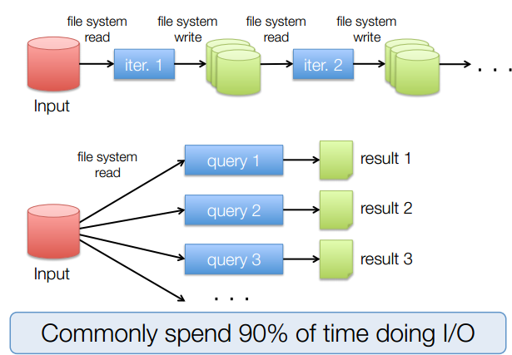
Example: Iterative Apps

Slide 62
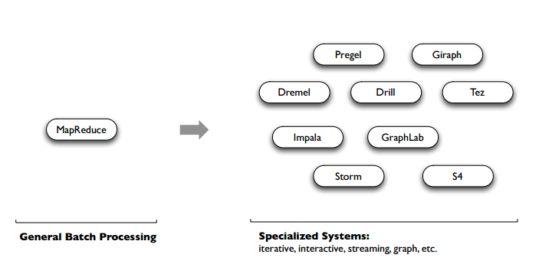
Unlike the various specialized systems, Spark’s goal was to generalize MapReduce to support new apps within same engine. This allows for an approach which is more efficient for the engine, and much simpler for the end users

Slide 63


Motivation
(2007 – 2015?)
(2004 – 2013)
Giraph
(2014 – ?)
Pregel
Tez
Drill
Dremel
Mahout
Storm
S4
Impala
GraphLab
General Batch Processing
General Unified Engine
Specialized Systems
(iterative, interactive, ML, streaming, graph, SQL, etc)

Slide 64
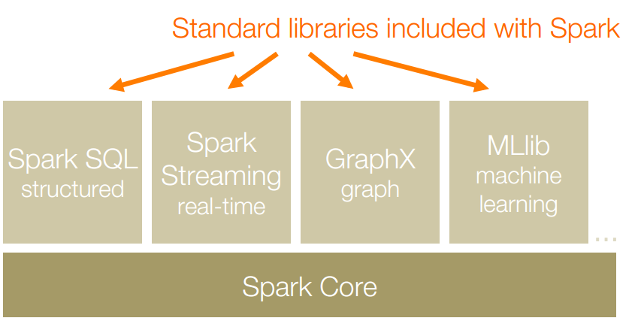
Apache Spark is a fast and general-purpose cluster computing system. It also supports a rich set of higher-level tools including Spark SQL for SQL and structured data processing, MLlib for machine learning, GraphX for graph processing, and Spark Streaming for streaming processing.

Slide 65
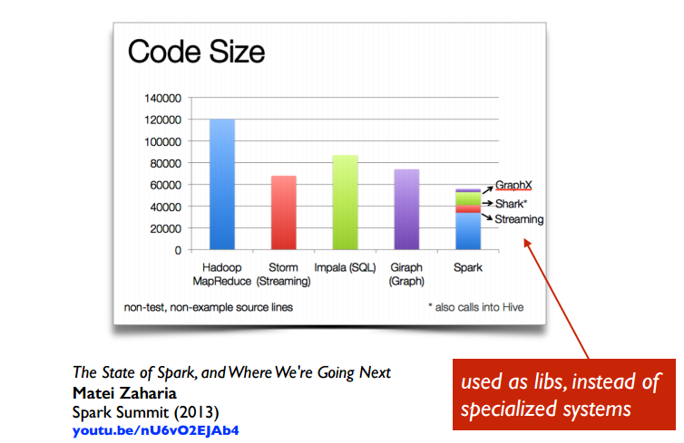

Slide 66
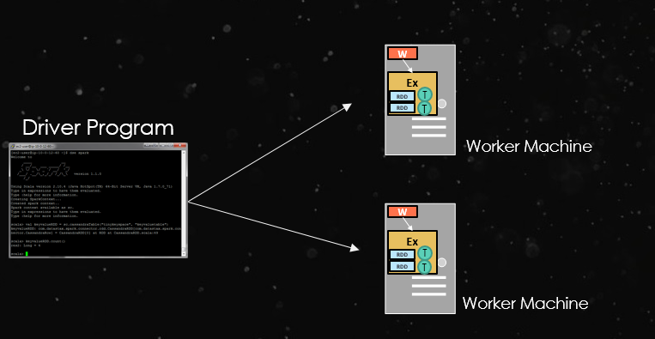
Basic Concept
At a high level, every Spark application consists of
a driver program that runs the user’s main function and
executes various parallel operationson a cluster.

Slide 67
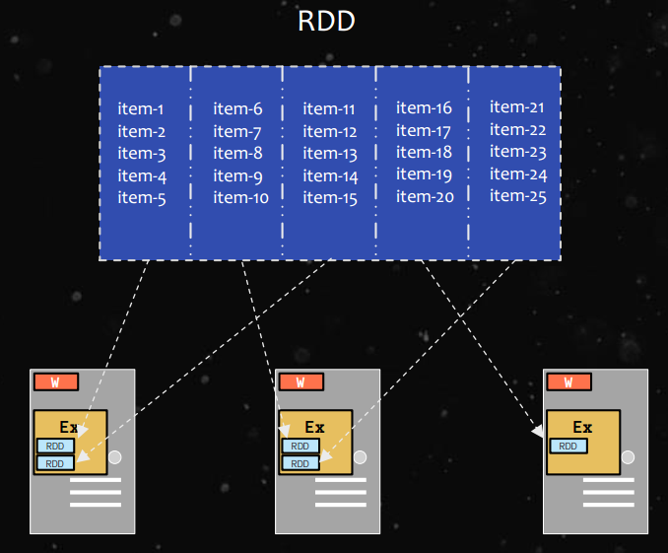
Basic Concept
The main abstraction in Spark is that of a resilient distributed dataset (RDD), which represents a read-only collection of objects partitioned across a set of machines that can be rebuilt if a partition is lost.

Slide 68
Creation of RDD
An RDD can be created 2 ways:
Parallelize a collection
Read data from an external source (S3, C*, HDFS, etc)
// Parallelize in Scala
val wordsRDD= sc.parallelize(List("fish", "cats", "dogs"))
//read data from an external source: val lines = sc.textFile(...)

Slide 69
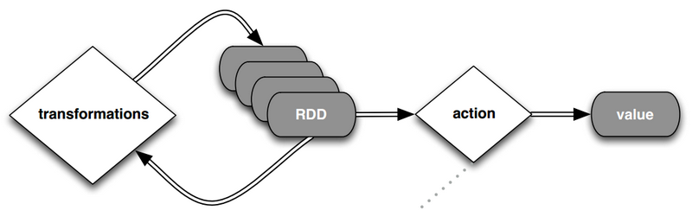
Operations on RDD
RDDs support two types of operations: transformations, which create a new dataset from an existing one, and actions, which return a value to the driver program after running a computation on the dataset.

Slide 70
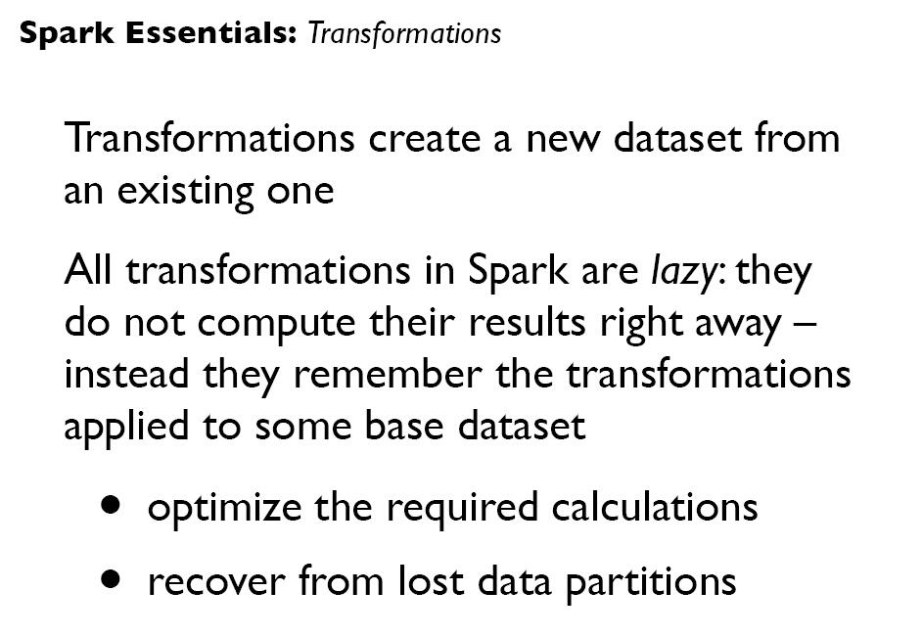

Slide 71
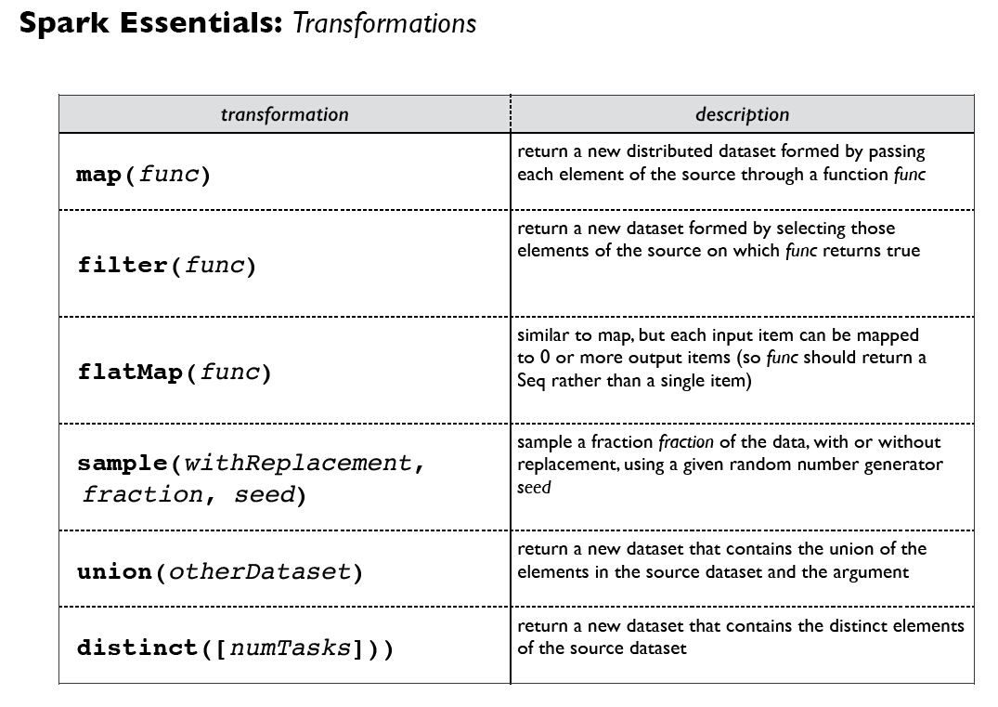

Slide 72
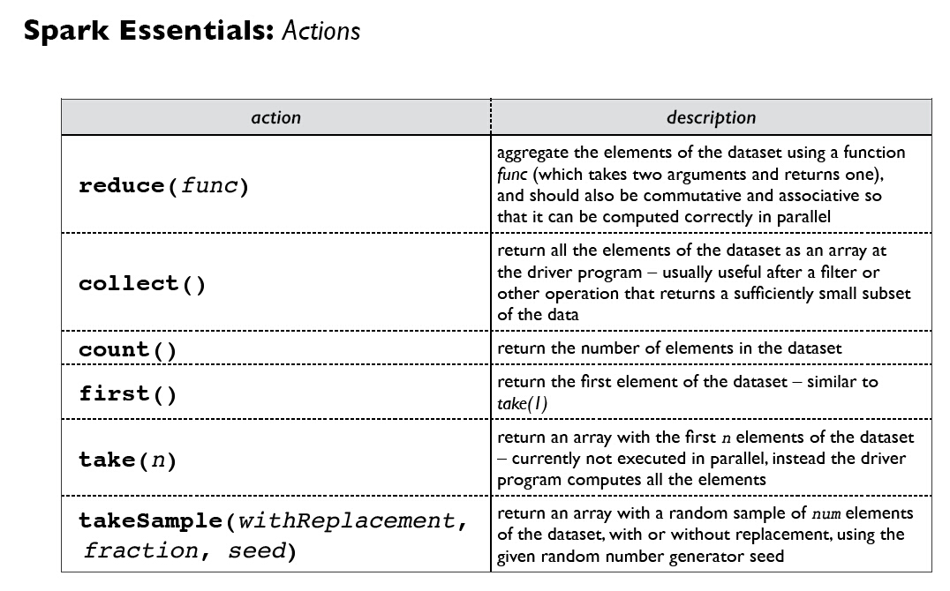

Slide 73
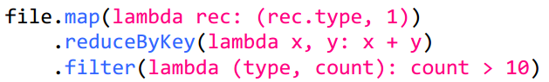
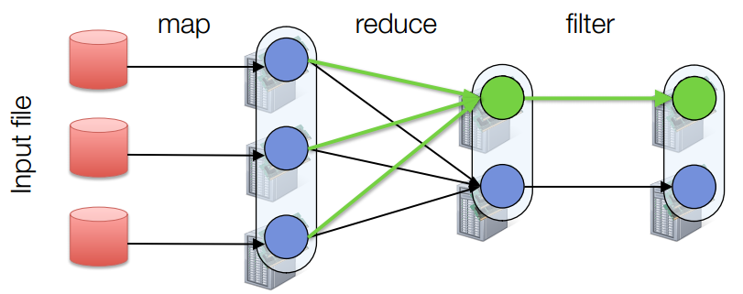
Fault Tolerance
RDDs track lineage info to rebuild lost data

Slide 74
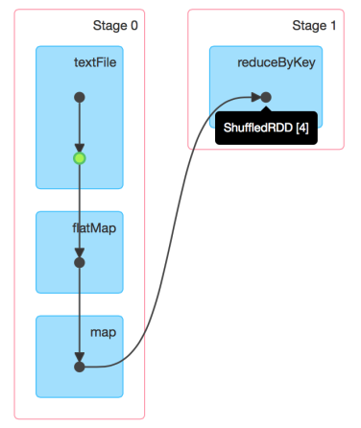
DAG of Word Count
Stage Graph
Needs to compute my parents, parents, parents, etc all the way back to an RDD with no dependencies .
Hadoop RDD
FilterMap RDD
Map RDD
Automatically rebuilt on failure

Slide 75
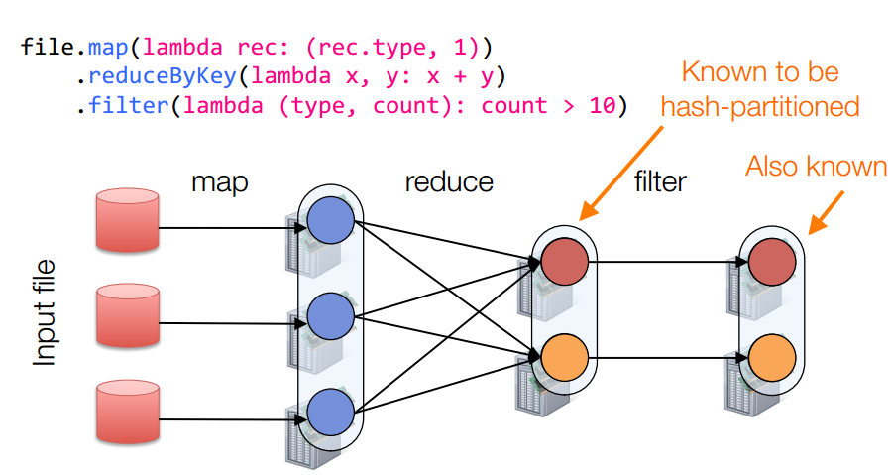
Partitioning
RDDs know their partitioning functions

Slide 76
Word Count of Spark
val lines = sc.textFile(“hamlet.txt”)
val counts = lines.flatMap( line=> line.split(“ ”)) .map(word => (word, 1)) .reduceByKey((x,y)=> x + y).collect()
textFile
flatMap
map
reducebyKey
“to” “be” “or”
(to, 1) (be, 1) (or, 1)
(be, 2) (not, 1)
(be, 2) (not, 1)
“to be or”
(or, 1)
(to, 2)
“not” “to” “be”
(not, 1) (to, 1) (be, 1)
(or, 1)
(to, 2)
“not to be”
Partition
RDD

Slide 77
MapReduce VS Spark
MapReduce
Great at one-pass computation, but inefficient for multi-pass algorithms.
No efficient primitives for data sharing.
Spark
Extends a programming language with a distributed collection data-structure（RDD）.
Clean APIs in Java, Scala, Python, R.

Slide 78
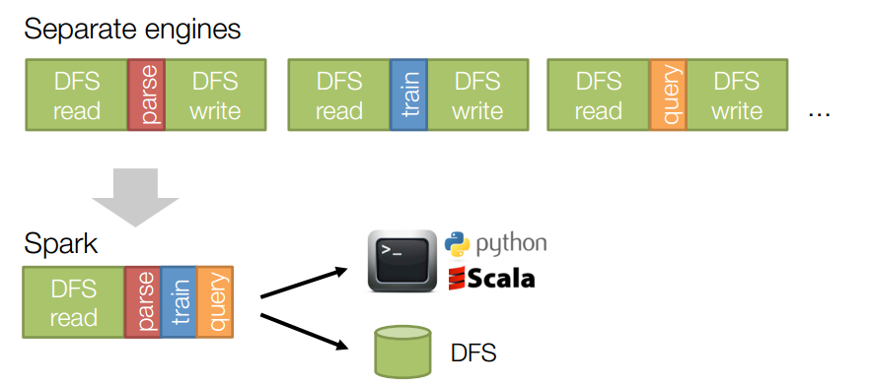
MapReduce VS Spark
Same engine performs data extraction, model training and interactive queries

